Slide 1
Introductions
Learning goals:
Understand Jupyter
Understand Datahub
Final Project team building and ideas
Q & A
COGS 108 Fall 2020
Atman Patel
Discussion 1
a2patel@eng.ucsd.edu
OH: Tue 11:30am -12:30pm
Discussion slides and materials adapted from Sam Lau (TA: WI20)

Slide 2

Welcome to COGS 108!
Atman Patel
2nd year MS student in ECE – Specialization in Machine Learning and Data Science
Research: Deep Learning, applications in Computer Vision
Interests: Ukulele (started learning), Soccer, table tennis

Slide 3
Section Philosophy
Attendance is not required
Reasons to never miss the discussion sessions:
Demos to help you set up and start working
Hands-on experience and personalized guidance
Discussion is not supposed to be a monologue – Please ask questions
Condensed information >> searching the infinite www

Slide 4
Zoom format
Lecture -> Demo -> Q/A. Please mute your microphone, but feel free to unmute and ask questions!
If you’re more comfortable with text -> Keep asking questions on chat -> TI or I will address them.
We will take up assignment specific questions towards the end of Discussion or during OH.

Slide 5
Project
From a group of 4-5 students (if you opt for group project option)
Feel free to talk to others right now! Post a message on common chat with your interests, region, skills etc.
Use piazza -> pinned post
Start working towards the project as soon as possible

Slide 6
Programming
This course assumes basic programming knowledge
But not much
Resources:
codeacademy
Start Here: https://github.com/COGS108/Tutorials/blob/master/01-Python.ipynb
Python in detail: https://jakevdp.github.io/PythonDataScienceHandbook/
Pandas: https://www.dataschool.io/python-pandas-tips-and-tricks/
Git: https://guides.github.com/activities/hello-world/
Cheatsheets
Google: ‘python cheatsheet’, ‘pandas cheatsheet’, ‘git cheatsheet’ (find one that’s good for you)

Slide 7
Anaconda
The Data Science Toolkit – contains Python and data science libraries (including jupyter notebooks)
Download: https://www.anaconda.com/products/individual
Installation: https://docs.anaconda.com/anaconda/install/
Verify installation: https://docs.anaconda.com/anaconda/install/verify-install/
Make sure anaconda is added to the system path: For mac: export PATH="/usr/local/anaconda3/bin:$PATH"

Slide 8
Git
Version control system!
Go to https://git-scm.com/downloads
Choose your Operating System (Windows/OS X/Linux)
Follow the steps specific to your OS
Verify installation: In terminal type “git –-version”

Slide 9

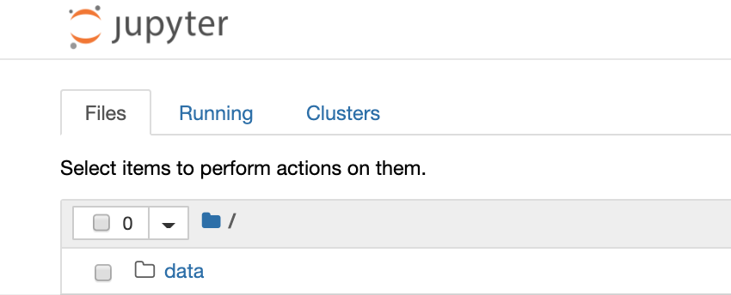
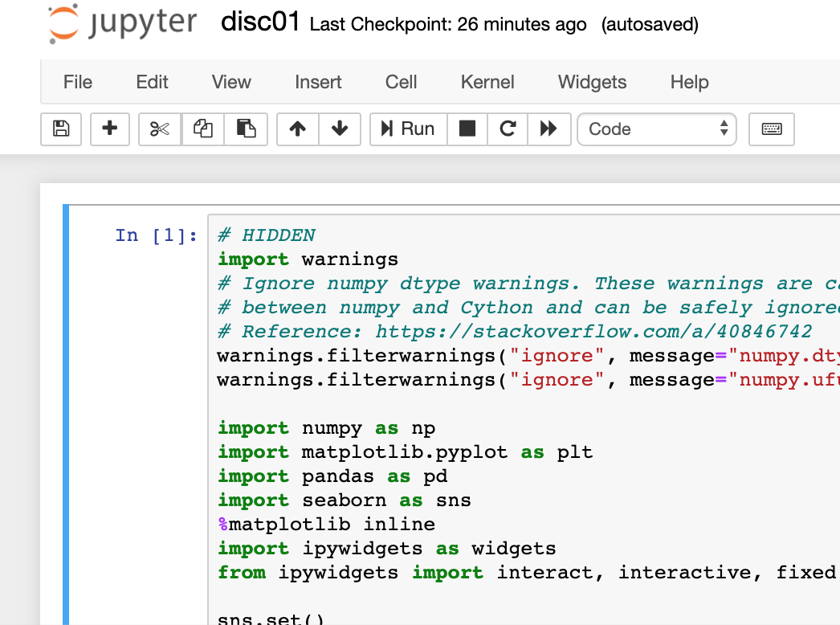
Jupyter
Python code is run on a python interpreter
Jupyter is a program that creates an interface for typing python code in a browser, that also runs that code in a python interpreter
What does this mean?!
Jupyter is a way of running python programs from a browser (like chrome) (hooray!)

Slide 10
Jupyter Demo
An example of what you can do with Jupyter
For today’s demo (includes both code and data): https://github.com/COGS108/Section-Fa20
But before we start, we need to learn about datahub!!

Slide 11

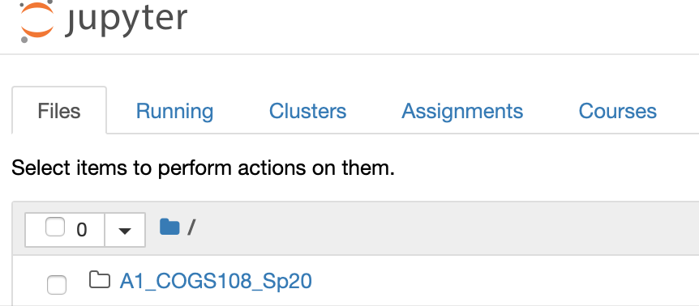
datahub
Jupyter runs python code in a browser.
But Jupyter is itself just a program that’s running on a computer somewhere.
datahub lets you interact with Jupyter that’s running somewhere else.
What does this mean?!
You don’t need to worry about installing Jupyter
You can use datahub to create and run python programs (online)
You can use this interface to fetch and submit assignments

Slide 12
Oakland License Plates
Get data and jupyter notebook –
Open datahub
Create a new folder called “Discussions”
Open Terminal
Go to Discussions folder
Type “Git clone https://github.com/COGS108/Section-Fa20”
Close Terminal
Open Jupyter notebook called disc01.ipynb (located in Discussions/Section_Fa20/disc01/)

Slide 13
Working on your assignments
Log into datahub.ucsd.edu
Go to Assignments tab
‘fetch’ assignments you have access to -> Submit after completion

Slide 14
Resources
\Most of the course related information: https://github.com/COGS108/Overview (It’ll be worth bookmarking this page. You’ll use it a lot)
For a long list of interesting datasets: https://tinyletter.com/data-is-plural
All Discussion Materials: https://github.com/COGS108/Section-Fa20
(Page above also has links to today’s demo and extra practice with Python.)
Next week: A1 help, git walkthrough

